Slide 1
Nilai Eigen dan Vektor Eigen
Aljabar Linier untuk Komputasi (KOM20A)
Pertemuan 11

Slide 2

Eigenvalue dan Eigenvector (review)
Materi diambil dari slide untuk buku Linear Algebra, David C Lay

Slide 3
Nilai Eigen dan Vektor Eigen
Definisi: An eigenvector of an matrix A is a nonzero vector x such that for some scalar λ. A scalar λ is called an eigenvalue of A if there is a nontrivial solution x of ; such an x is called an eigenvector corresponding to λ.
λ is an eigenvalue of an matrix A if and only if the equation
----(1)
has a nontrivial solution.
The set of all solutions of (1) is just the null space of the matrix .

Slide 4
Eigenvectors and Eigenvalues
So this set is a subspace of ℝ^{n} and is called the eigenspace of A corresponding to λ.
The eigenspace consists of the zero vector and all the eigenvectors corresponding to λ.
Example 1: Show that 7 is an eigenvalue of matrix
and find the corresponding eigenvectors.

Slide 5
Eigenvectors and Eigenvalues
Solution: The scalar 7 is an eigenvalue of A if and only if the equation
----(1)
has a nontrivial solution.
But (1) is equivalent to , or
----(2)
To solve this homogeneous equation, form the matrix

Slide 6
Eigenvectors and Eigenvalues
The columns of are obviously linearly dependent, so (3) has nontrivial solutions.
To find the corresponding eigenvectors, use row operations:
The general solution has the form .
Each vector of this form with is an eigenvector corresponding to .

Slide 7
Eigenvectors and Eigenvalues
Example 2: Let . An eigenvalue of
A is 2. Find a basis for the corresponding eigenspace.
Solution: Form
and row reduce the augmented matrix for .

Slide 8
Eigenvectors and Eigenvalues
At this point, it is clear that 2 is indeed an eigenvalue of A because the equation has free variables.
The general solution is
, x₂ and x₃ free.

Slide 9
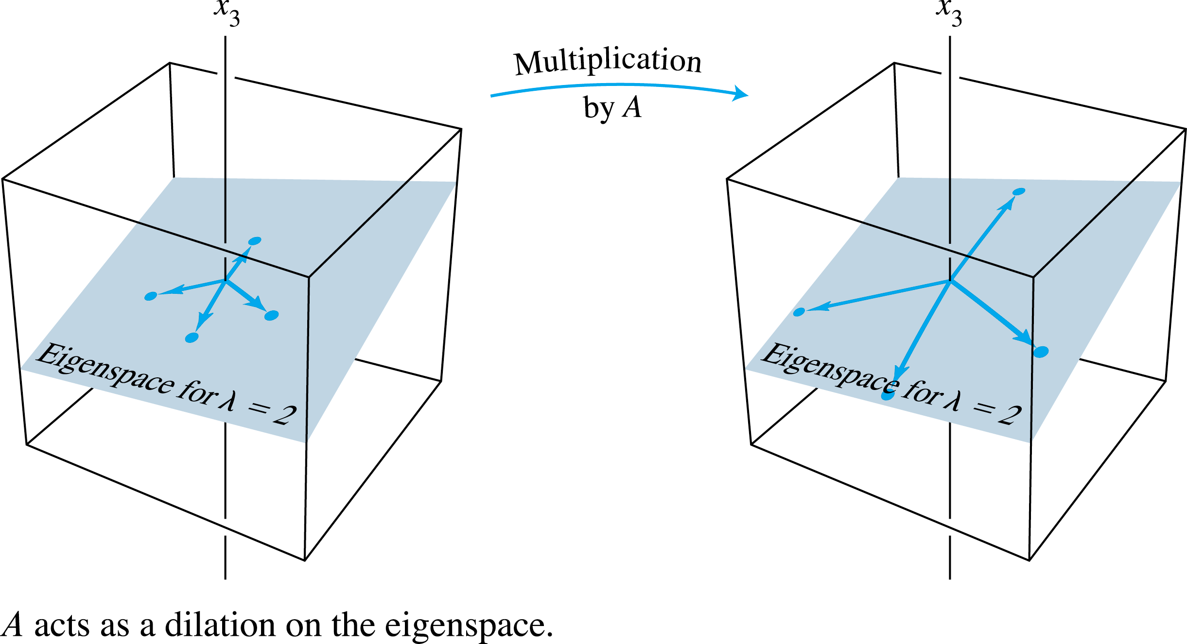
Eigenvectors and Eigenvalues
The eigenspace, shown in the following figure, is a two-dimensional subspace of ℝ³.
A basis is

Slide 10
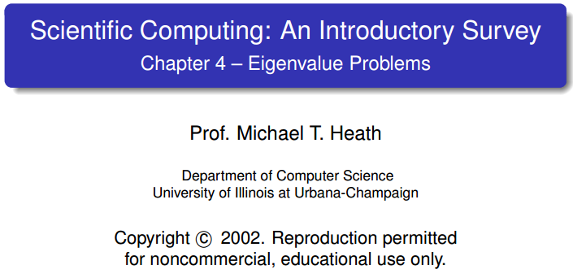
Characteristic Polynomial
Equation Ax = λx is equivalent to
(A − λI)x = 0
which has nonzero solution x if, and only if, its matrix is
singular
Eigenvalues of A are roots λ_{I} of characteristic polynomial
det(A − λI) = 0
in λ of degree n.

Slide 11
Exercise
Find eigenvalues and eigenvectors of the following matrix
Find the eigenvalues and corresponding eigenvectors for the matrix A. What is the dimension of the eigenspace of each eigenvalue?

Slide 12
Ex 1: Finding eigenvalues and eigenvectors
Sol: Characteristic equation:
Eigenvalue:
Sumber: http://homepage.ntu.edu.tw/~jryanwang/course/Mathematics%20for%20Management%20( undergraduate%20level)/MM_undergraduate.htm

Slide 13
Sumber: http://homepage.ntu.edu.tw/~jryanwang/course/Mathematics%20for%20Management%20( undergraduate%20level)/MM_undergraduate.htm

Slide 14
Ex 2: Finding eigenvalues and eigenvectors
Find the eigenvalues and corresponding eigenvectors for the matrix A. What is the dimension of the eigenspace of each eigenvalue?
Sol: Characteristic equation:
Eigenvalue:
Sumber: http://homepage.ntu.edu.tw/~jryanwang/course/Mathematics%20for%20Management%20( undergraduate%20level)/MM_undergraduate.htm

Slide 15
The eigenspace of λ = 2:
Thus, the dimension of its eigenspace is 2
Sumber: http://homepage.ntu.edu.tw/~jryanwang/course/Mathematics%20for%20Management%20( undergraduate%20level)/MM_undergraduate.htm

Slide 16
Applications of Eigenvalues and Eigenvectors
Sumber: http://homepage.ntu.edu.tw/~jryanwang/course/Mathematics%20for%20Management%20( undergraduate%20level)/MM_undergraduate.htm

Slide 17
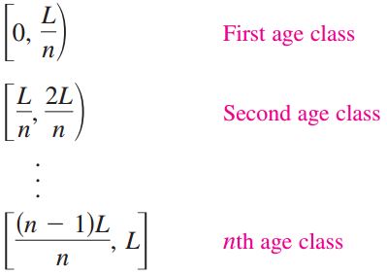
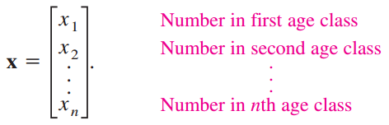
Population Growth
Matrices can be used to form models for population growth. The first step in this process is to group the population into age classes of equal duration.
For instance, if the maximum life span of a member is L years, then the following intervals represent the age classes
The age distribution vector represents the number of population members in each
age class, where

Slide 18
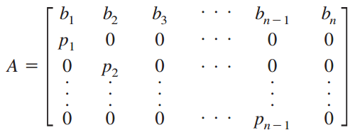
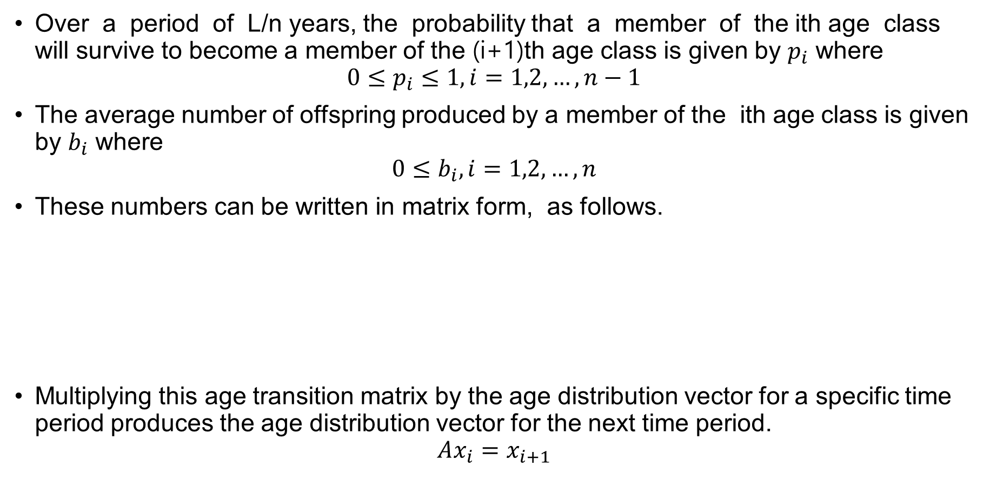
Population Growth
Over a period of L/n years, the probability that a member of the ith age class will survive to become a member of the (i+1)th age class is given by $p_{i}$ where
$${0≤p}_{i}≤1, i=1,2,…,n−1$$
The average number of offspring produced by a member of the ith age class is given by $b_{i}$ where
$${0≤b}_{i}, i=1,2,…,n$$
These numbers can be written in matrix form, as follows.
Multiplying this age transition matrix by the age distribution vector for a specific time period produces the age distribution vector for the next time period.
$$Ax_{i}=x_{i+1}$$

Slide 19
Population Growth – Example 1
A population of rabbits has the following characteristics.
Half of the rabbits survive their first year. Of those, half survive their second year. The maximum life span is 3 years.
During the first year, the rabbits produce no offspring. The average number of offspring is 6 during the second year and 8 during the third year.
The population now consists of 24 rabbits in the first age class, 24 in the second, and 20 in the third. How many rabbits will there be in each age class in 1 year?

Slide 20
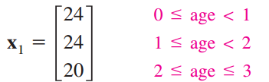
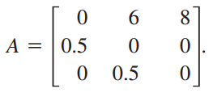
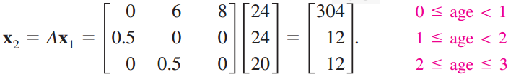
Population Growth – Example 1
The current age distribution vector is
and the age transition matrix is
After 1 year, the age distribution vector will be

Slide 21

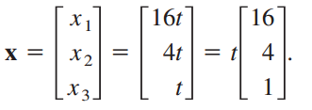
Population Growth – Example 2
Find a stable age distribution vector for the population in Example 1
Solution:
To solve this problem, find an eigenvalue λ and a corresponding eigenvector x such that Ax = λx. The characteristic polynomial of A is
which implies that the eigenvalues are −1 and 2. Choosing the positive value, let λ = 2. Verify that the corresponding eigenvectors are of the form
Tunjukan !!

Slide 22
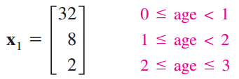
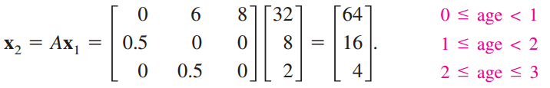
Population Growth – Example 2
For instance, if t = 2 then the initial age distribution vector would be
and the age distribution vector for the next year would be
Notice that the ratio of the three age classes is still 16 : 4 : 1, and so the percent of the population in each age class remains the same

Slide 23
Principal Component Analysis
Principal component analysis
It is a way of identifying the underlying patterns in data
It can extract information in a large data set with many variables and approximate this data set with fewer factors
In other words, it can reduce the number of variables to a more manageable set
Steps of the principal component analysis
Step 1: Get some data
Step 2: Subtract the mean
Step 3: Calculate the covariance matrix
Step 4: Calculate the eigenvectors and eigenvalues of the
covariance matrix
Step 5: Deriving the transformed data set
Step 6: Getting the original data back
Sumber: http://homepage.ntu.edu.tw/~jryanwang/course/Mathematics%20for%20Management%20( undergraduate%20level)/MM_undergraduate.htm

Slide 24
Step 1:
Step 2:
x | y
2.5 | 2.4
0.5 | 0.7
2.2 | 2.9
1.9 | 2.2
3.1 | 3.0
2.3 | 2.7
2.0 | 1.6
1.0 | 1.1
1.5 | 1.6
1.1 | 0.9
1.81 | 1.91
x | y
0.69 | 0.49
-1.31 | -1.21
0.39 | 0.99
0.09 | 0.29
1.29 | 1.09
0.49 | 0.79
0.19 | -0.31
-0.81 | -0.81
-0.31 | -0.31
-0.71 | -1.01
0 | 0
Step 3:
Sumber: http://homepage.ntu.edu.tw/~jryanwang/course/Mathematics%20for%20Management%20( undergraduate%20level)/MM_undergraduate.htm

Slide 25
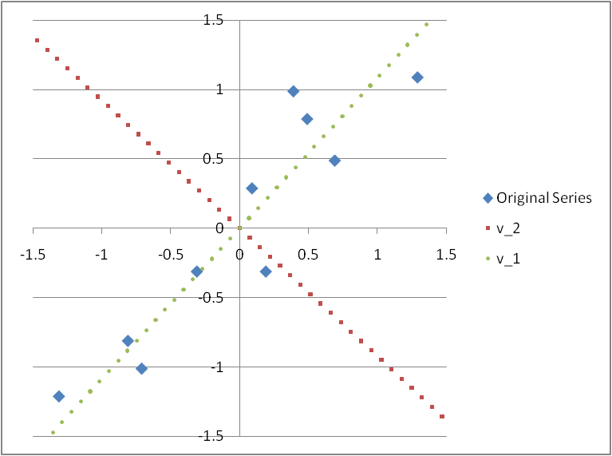
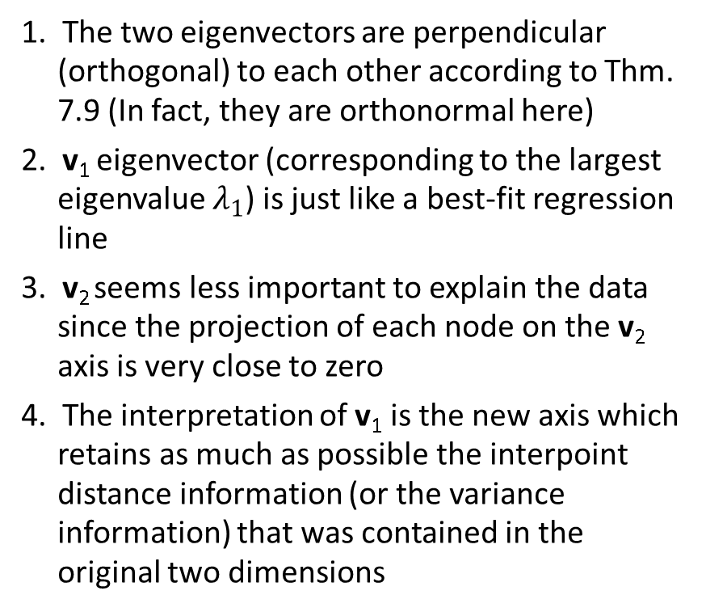
Step 4: Calculate the eigenvectors and eigenvalues of the covariance matrix A
1. The two eigenvectors are perpendicular (orthogonal) to each other according to Thm. 7.9 (In fact, they are orthonormal here)
2. v₁ eigenvector (corresponding to the largest eigenvalue $λ_{1}$) is just like a best-fit regression line
3. v₂ seems less important to explain the data since the projection of each node on the v₂ axis is very close to zero
4. The interpretation of v₁ is the new axis which retains as much as possible the interpoint distance information (or the variance information) that was contained in the original two dimensions
Sumber: http://homepage.ntu.edu.tw/~jryanwang/course/ Mathematics%20for%20Management%20( undergraduate%20level)/MM_undergraduate.htm

Slide 26
※ The intuition behind the principal component analysis:
(It also implies that the new series of x’ and y’ are independent)

Slide 27
Step 5: Deriving the transformed data set:
x’ | y’
-0.82797 | -0.17512
1.77758 | 0.14286
-0.99220 | 0.38437
-0.27421 | 0.13042
-1.67580 | -0.20950
-0.91295 | 0.17528
0.09911 | -0.34982
1.14457 | 0.04642
0.43805 | 0.01776
1.22382 | -0.16268
0 | 0
x’ | y’
-0.82797 | 0
1.77758 | 0
-0.99220 | 0
-0.27421 | 0
-1.67580 | 0
-0.91295 | 0
0.09911 | 0
1.14457 | 0
0.43805 | 0
1.22382 | 0
0 | 0

Slide 28
Step 6: Getting the original data back:
case 1 case 2
x | y
2.5 | 2.4
0.5 | 0.7
2.2 | 2.9
1.9 | 2.2
3.1 | 3
2.3 | 2.7
2 | 1.6
1 | 1.1
1.5 | 1.6
1.1 | 0.9
1.81 | 1.91
x | y
2.37 | 2.52
0.61 | 0.60
2.48 | 2.64
2.00 | 2.11
2.95 | 3.14
2.43 | 2.58
1.74 | 1.84
1.03 | 1.07
1.51 | 1.59
0.98 | 1.01
1.81 | 1.91
※ We can derive the original data set if we take both v₁ and v₂ and thus x’ and y’ into account when deriving the transformed data
※ Although when we derive the transformed data, only v₁ and thus only x’ are considered, the data gotten back is still similar to the original data. That means, x’ can be a common factor almost able to explain both series x and y

Slide 29
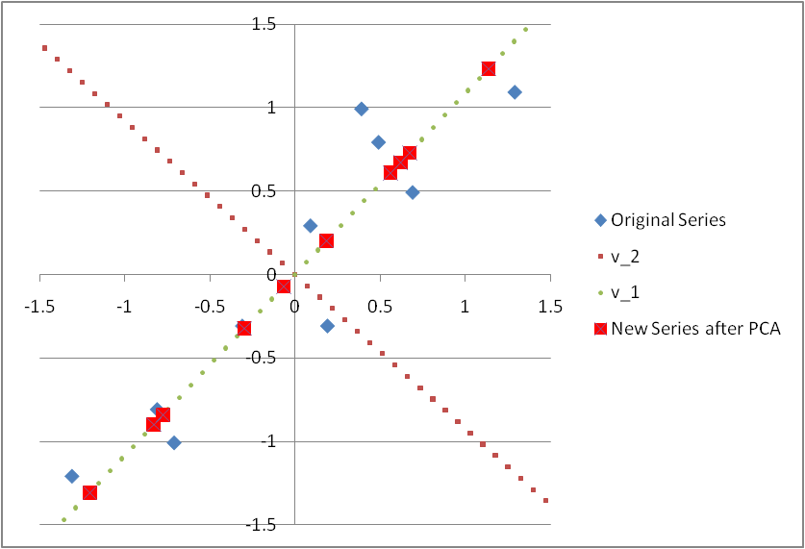
※ If only the principal component x’ is considered in the Principal Component Analysis (PCA), it is equivalent to project all points onto the v₁ vector
※ It can be observed in the above figure that the projection onto v₁ vector can retains as much as possible the interpoint distance information (variance) that was contained in the original series of (x, y)

Slide 30
Factor loadings: the correlations between the principal components (F₁ = x’ and F₂ = y’) and the original variables (x₁ = x and x₂ = y)
Factor loadings are used to identify and interpret the unobservable principal components
※ The factor loadings of x’ on x and y are close to 1 in absolute levels, which implies the principal component x’ can explain x and y quite well and thus x’ can viewed as an index to represent the combined information of x and y

